Slide 1
SQL Server
T-SQL
In all slides, db=database

Slide 2
T-SQL
Transact SQL or (T-SQL) is SQL Server’s dialect of Structured Query Language (SQL).

Slide 3
Basic SELECT Statement
The SELECT statement and the structures used within it form the basis for commands we will perform with the SQL Server.
The keyword ‘SELECT’ is the part that tells SQL Server what we are doing.

Slide 4
The SELECTStatement/From
By using ‘SELECT’, we are requesting to see information.
The * is a wildcard – we want to select every column FROM the table.
The ‘FROM’ indicates where we are pulling the data – the source.
SELECT * FROM INFORMATION_SCHEMA.TABLES

Slide 5
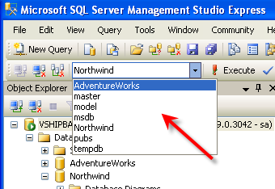
Choosing Database
To select the database to work FROM, use the drop down box on the left side:

Slide 6
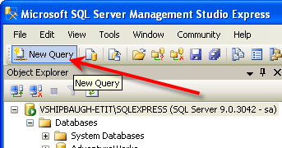
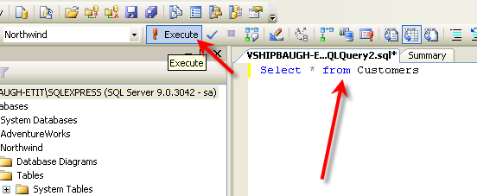
Running a Query
Click the ‘New Query’ button:
Type the query in the query window and press ‘Execute’:

Slide 7
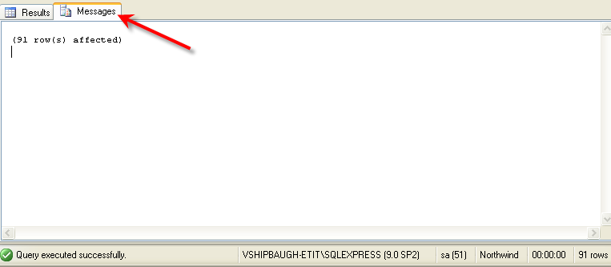
Query Results
This query will give us every row of data in every column.
Clicking on the ‘Messages’ tab provides further information:

Slide 8
The WHERE clause
The WHERE clause allows us to place conditions on what is returned:
This query will return all columns FROM the table ‘Customers’ WHERE the Column City is equal to ‘London’.
Note the value for city is in single quotes – all string values must be in single quotes – integer values are not quoted:
SELECT* FROM Customers WHERE City='London'
SELECT* FROM Employees WHERE EmployeeID=2

Slide 9
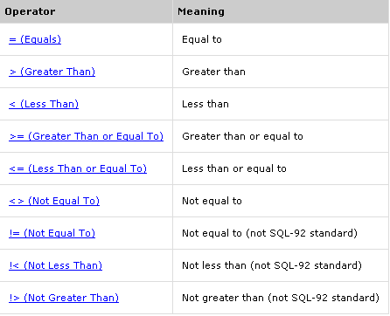
Comparison Operators

Slide 10
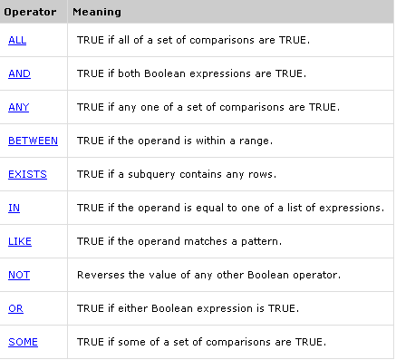
Other Operators

Slide 11
Order By
Order by is similar to ‘sort by’.
Defines the order the data will be returned.

Slide 12
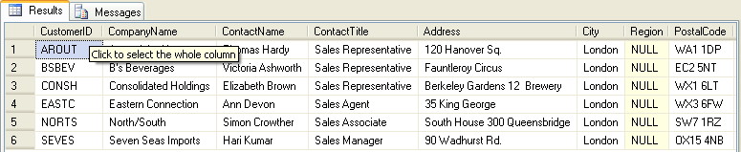
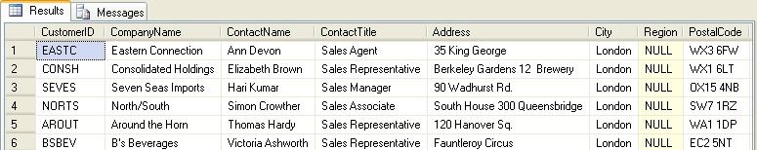
Order By cont.
Compare the following queries:
SELECT* FROM Customers WHERE City='London'
SELECT* FROM Customers WHERE City='London‘ Order by ContactName

Slide 13
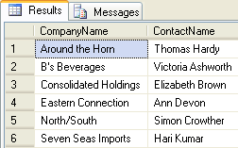
Selecting Particular Columns
Instead of SELECT *, we specified we only wanted CompanyName and Contact Name to be returned.
SELECT CompanyName,ContactName FROM Customers WHERE City='London'

Slide 14
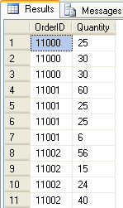
Group By
Group by is used to aggregate information.
Query without Group By:
SELECT OrderID, Quantity FROM [Order Details] WHERE OrderID BETWEEN 11000 and 11002
Remember why we use those brackets[]? Because the column name has a space in it, we have to use the brackets so that the query understands what column name we are referring to. Again, it is a good idea to NOT use spaces in column names

Slide 15
Group By cont.
The SUM function returns totals – but totals of what? If the GROUP BY clause was not supplied, the SUM would have been of all the values in all the orws for the named column.
SELECT OrderID, SUM(Quantity) FROM [Order Details] WHERE OrderID BETWEEN 11000 and 11002 GROUP BY OrderID

Slide 16

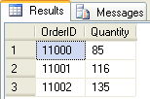
Using AS (alias)
Using a function like SUM without an alias will return a column with no name – we use AS to specify a column name.
SELECT OrderID, SUM(Quantity) FROM [Order Details] WHERE OrderID BETWEEN 11000 and 11002 GROUP BY OrderID
SELECT OrderID, SUM(Quantity) AS Quantity FROM [Order Details] WHERE OrderID BETWEEN 11000 and 11002 GROUP BY OrderID

Slide 17

AVG
This is used to compute averages.
SELECT OrderID, AVG(Quantity) AS Average FROM [Order Details] WHERE OrderID BETWEEN 11000 and 11002 GROUP BY OrderID

Slide 18



Min/Max
SELECT OrderID, MIN(Quantity) AS MinQuantity FROM [Order Details] WHERE OrderID BETWEEN 11000 and 11002 GROUP BY OrderID
SELECT OrderID, MAX(Quantity) AS MaxQuantity FROM [Order Details] WHERE OrderID BETWEEN 11000 and 11002 GROUP BY OrderID
SELECT OrderID, MIN(Quantity) AS MinQuantity, MAX(Quantity) AS MaxQuantity FROM [Order Details] WHERE OrderID BETWEEN 11000 and 11002 GROUP BY OrderID

Slide 19



Count(*)
Counts the rows in a query. The * once again indicates all columns.
SELECT COUNT(*) AS EmpCount FROM Employees WHERE EmployeeID=5
SELECT COUNT(*) AS EmpCount FROM Employees
SELECT COUNT(PhotoPath) AS EmpImageCount FROM Employees

Slide 20

Having
The HAVING clause allows us to quickly pare down the results to just the few in which we may be interested in.
SELECT OrderID, SUM(Quantity) AS Quantity FROM [Order Details] GROUP BY OrderID HAVING SUM(Quantity)>300

Slide 21


Distinct
Used to filter out duplicate rows.
SELECT SupplierID FROM Products WHERE UnitsInStock>0
SELECT DISTINCT SupplierID FROM Products WHERE UnitsInStock>0

